Slide 1


ADMIS Lab
先进数据与机器智能系统实验室
作业习题评讲课
数据库系统原理课程
2024

Slide 2
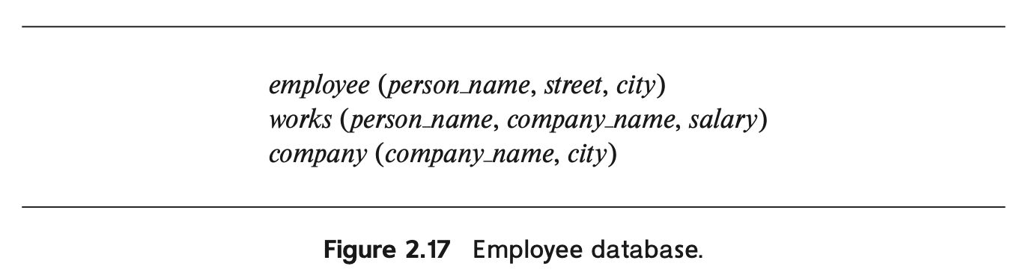
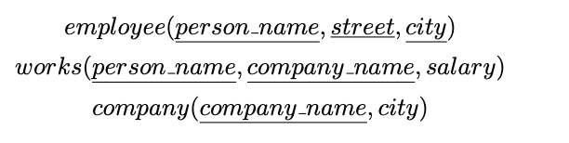
第一次作业 2.1

Slide 3
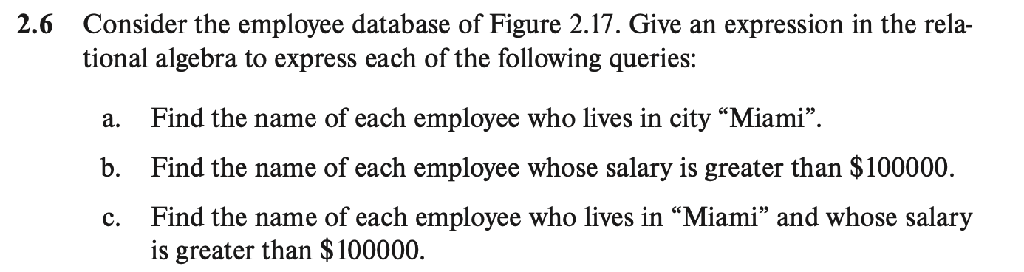
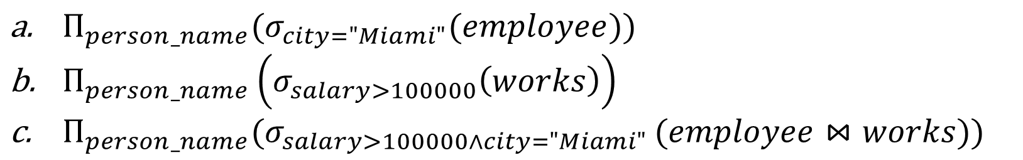
第一次作业 2.6
答案：
$Π_{person_name}(σ_{city="Miami"}(employee))$
$Π_{person_name}\left(σ_{salary>100000}\left(works\right)\right)$
$Π_{person_name}(σ_{salary>100000∧city="Miami" }(employee⋈works))$

Slide 4
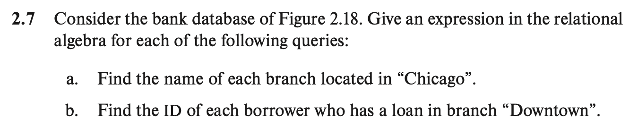
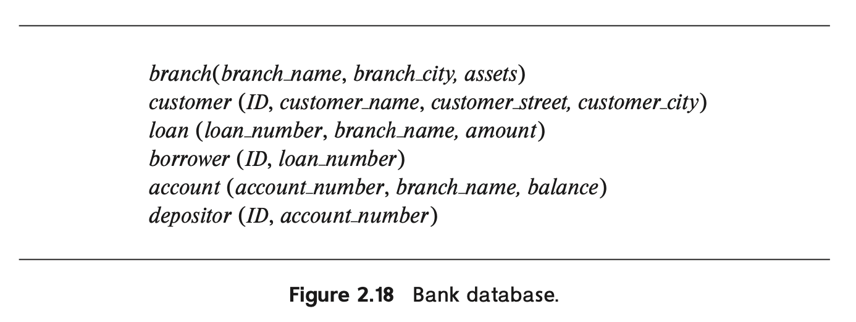
第一次作业 2.7
答案：
$Π_{branch_name}(σ_{branch_city="Chicago"}(branch))$
$Π_{ID}(σ_{branch_city="Downtown" }(borrwer⋈loan))$

Slide 5
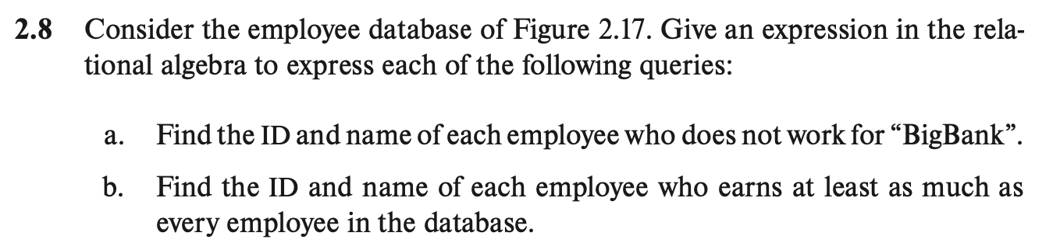
第一次作业 2.8
答案：
$Π_{ID,person_name}\left(works\right)−Π_{ID,person_name}\left(σ_{company_name="BigBank"}\left(works\right)\right)$
$1$

Slide 6
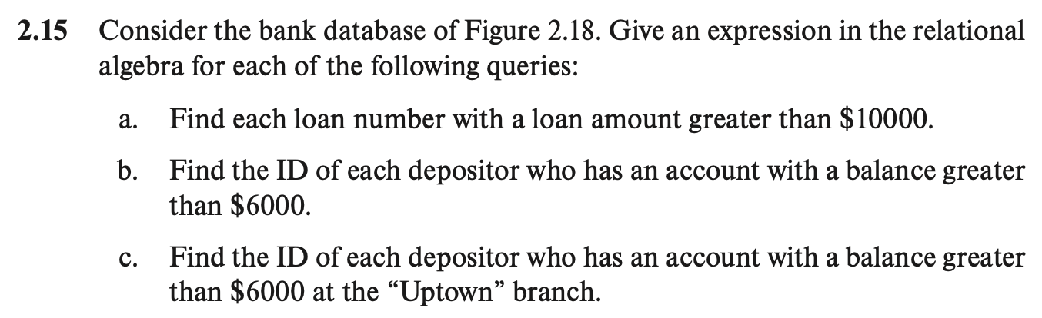
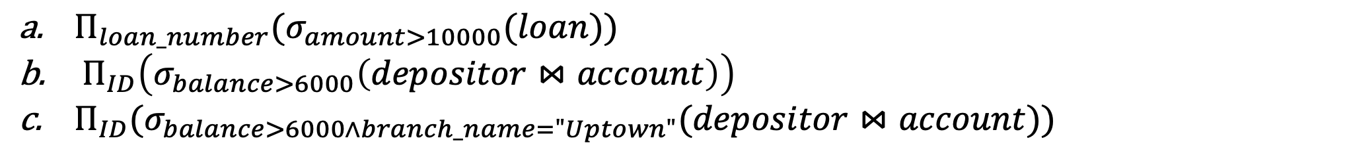
第一次作业 2.15
答案：
$Π_{loan_number}(σ_{amount>10000}(loan))$
$Π_{ID}\left(σ_{balance>6000}\left(depositor⋈account\right)\right)$
$Π_{ID}(σ_{balance>6000∧branch_name="Uptown"}(depositor⋈account))$

Slide 7
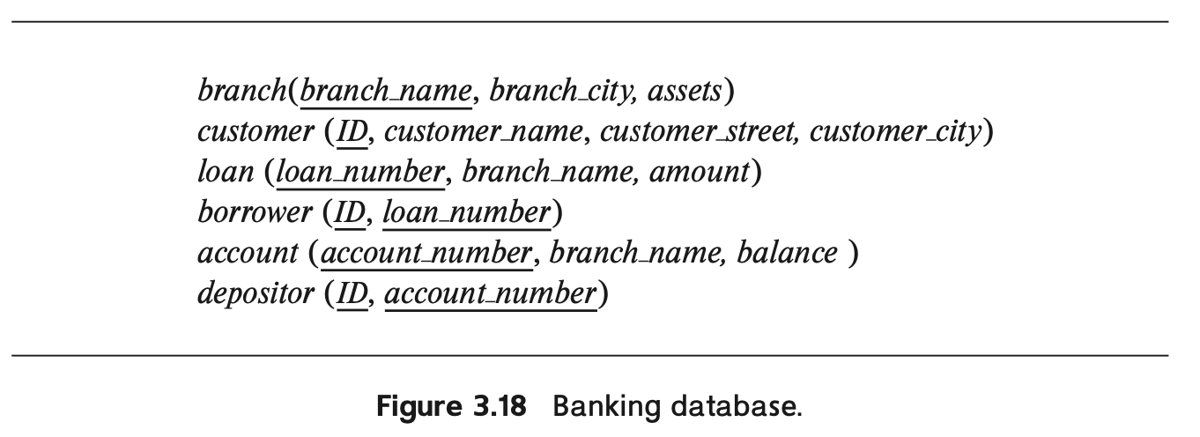
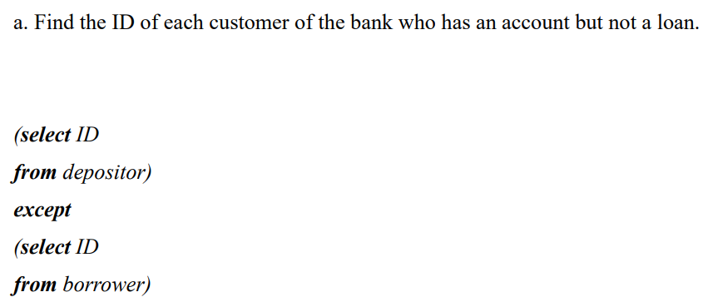
第二次作业 3.8

Slide 8
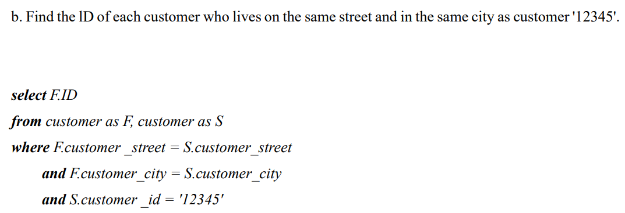
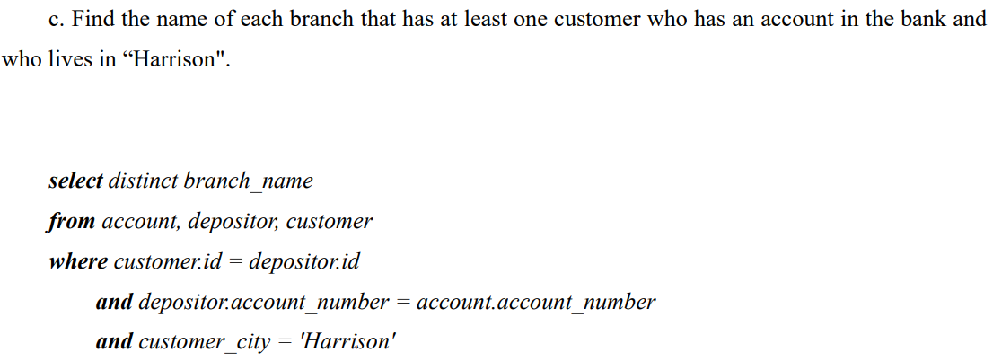
第二次作业 3.8

Slide 9
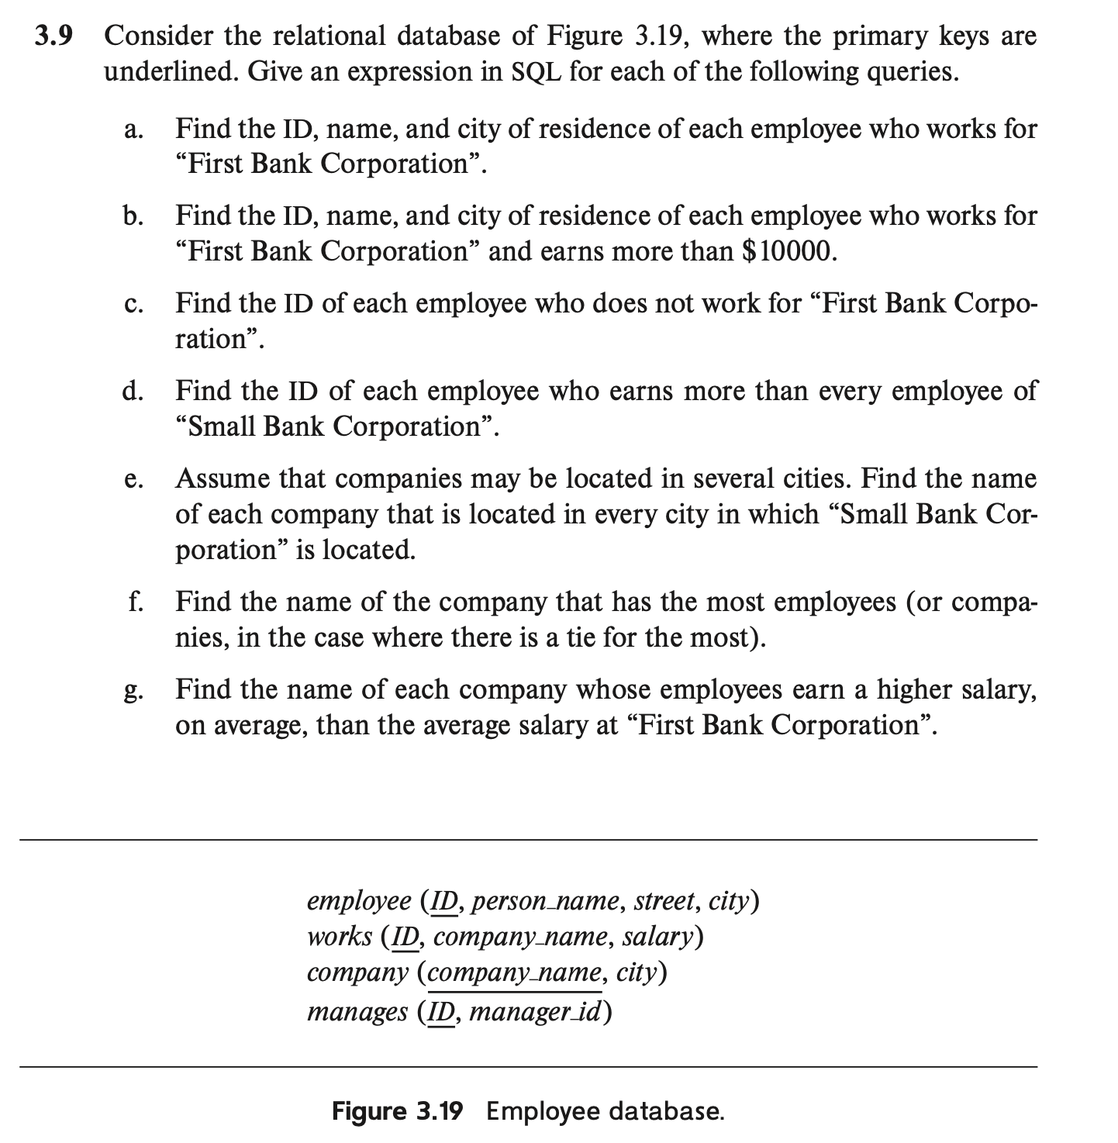
第二次作业 3.9
a.
select E.ID, E.persone_name, E.city
from employee as E, works as W
where E.ID = W.ID and W.company_name = "First Bank Corporation"
b.
select E.ID, E.persone_name, E.city
from employee as E, works as W
where E.ID = W.ID
and W.company_name = "First Bank Corporation"
and W.salary>10000
c.
select ID
from works
where company_name < > "First Bank Corporation"
d.
select ID
from works
where salary >all( select salary
from works
where company_name = "Small Bank Corporation"

Slide 10
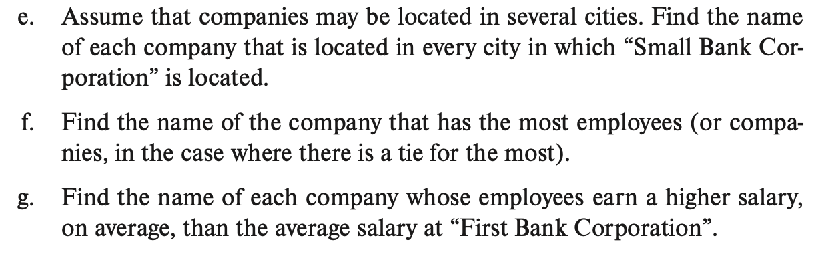
第二次作业 3.9
e.
select C.company_name
from company as C
where not exists (select city
from company
where company_name = "Small Bank Corporation"
except (select D.city from company as D
where D.company_name = C.company_name))
f.
select company_name
from works
group by company_name
having count(distinct ID) >= all(
select count(distinct ID) from works group by company_name)
g.
select company_name
from works
group by company_name
having avg(salary) > (select avg(salary) from works
where company_name = " First Bank Corporation")

Slide 11
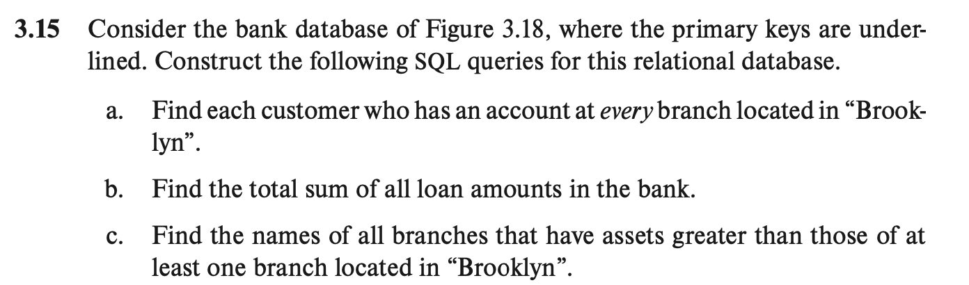
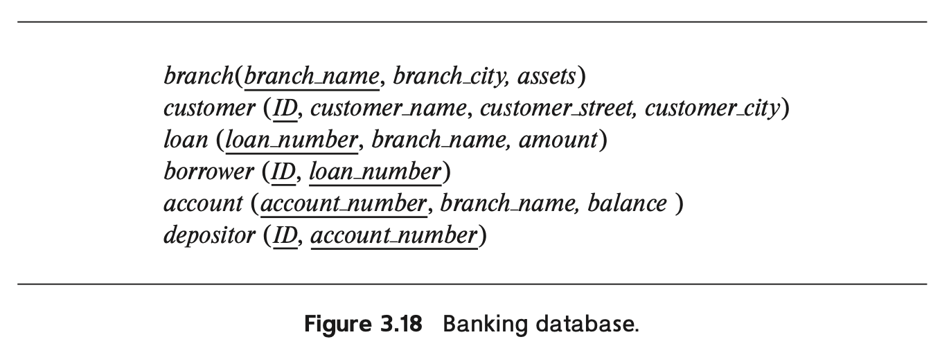
第二次作业 3.15

Slide 12
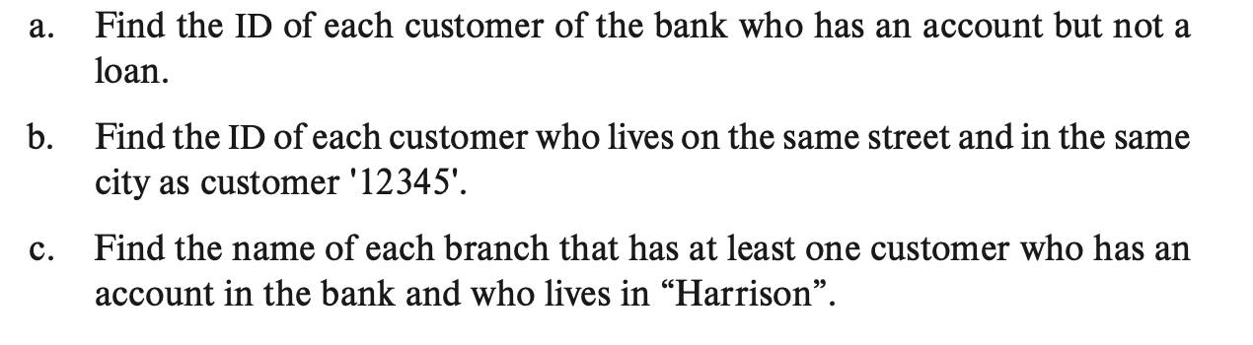
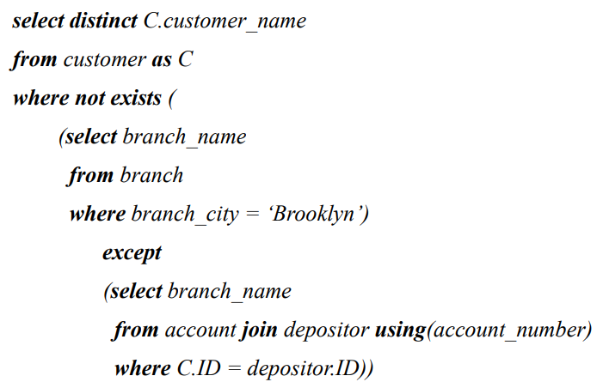
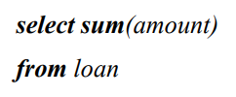
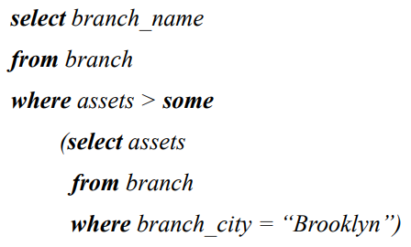
第二次作业 3.15
a.
b.
c.

Slide 13
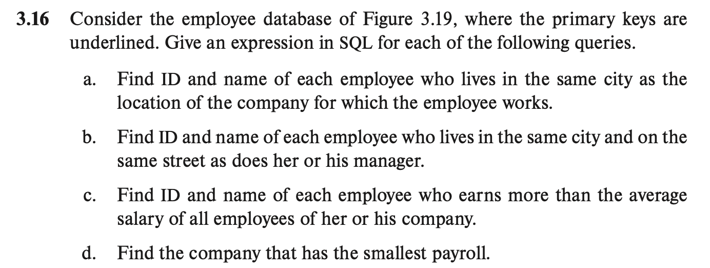
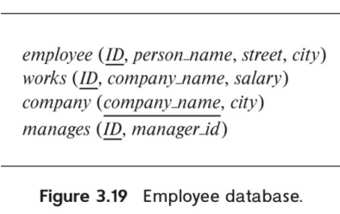
第二次作业 3.16
a.
select ID, person_name
from (employee natural join works) natural join company
b.
select E.ID, E.person_name
from employee as E, employee as D, manages
where E.ID = manages.ID
and D.ID = manages.manager_id
and E.street = D.street
and E.city = D.city
c.
select ID, person_name
from works as A
where salary > (select avg(salary)
from works as W
where W. company_name = A. company_name)
d.
select company_name
from works
group by company_name
having sum(salary) <= all(select sum(salary)
from works
group by company_name)

Slide 14
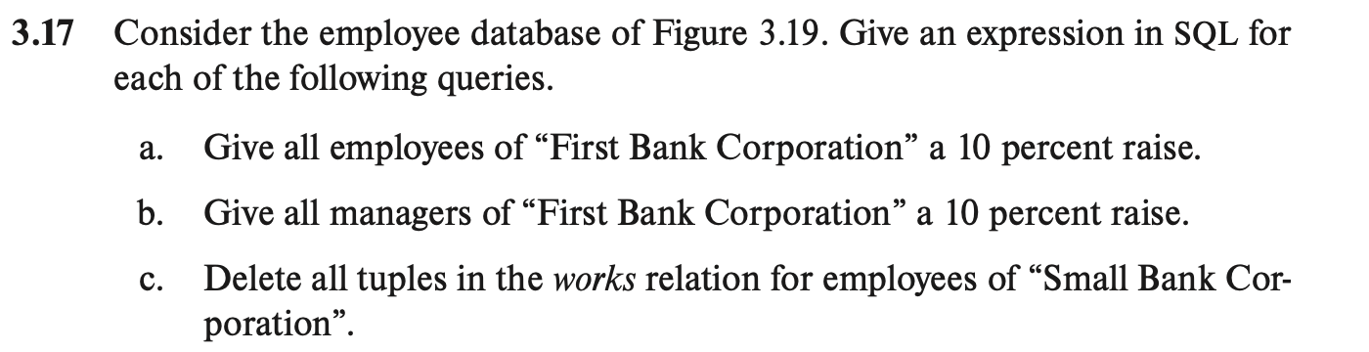
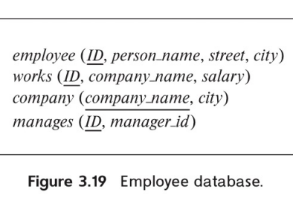
第二次作业 3.17
a.
update works
set salary = salary * 1.1
where company_name = "First Bank Corporation"
b.
update works
set salary = salary * 1.1
where works.company_name = "First Bank Corporation"
and ID in (select distinct manager_id
from manages)
c.
delete from works
where company_name ="Small Bank Corporation"

Slide 15
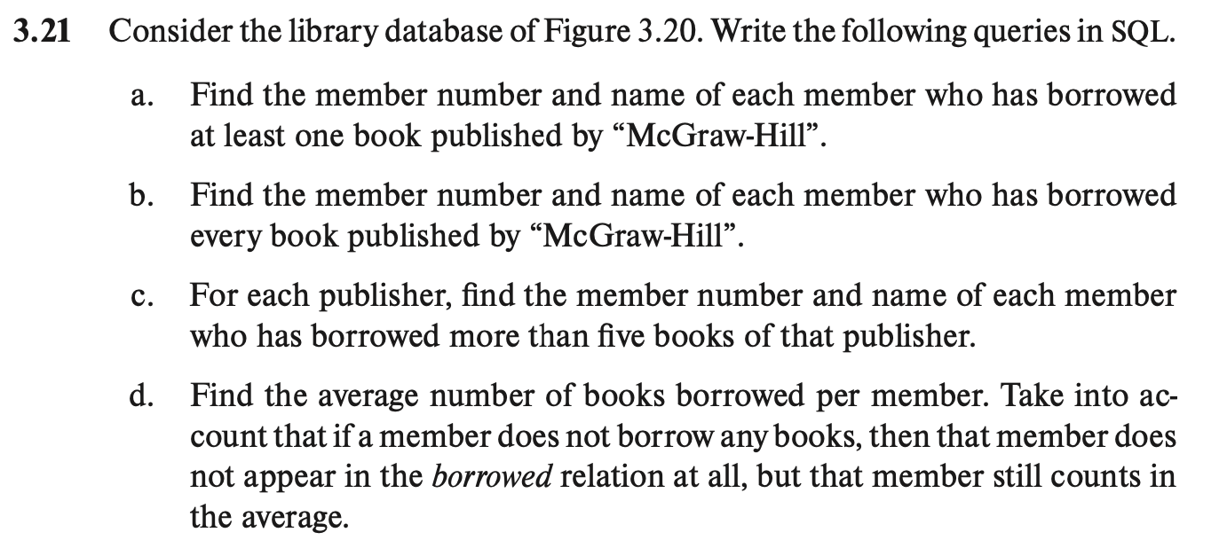
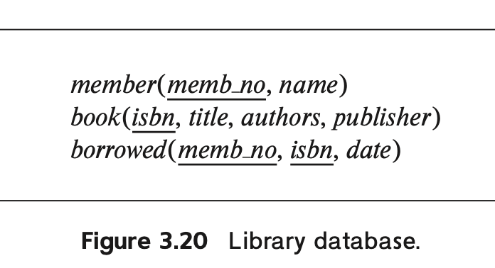
第二次作业 3.21
a.
select M.memb_no, M.name
from member M, book B, borrowed C
where C.memb_no = M.memb_no
and B.isbn = C.isbn
and B.publisher = "McGraw-Hill"
b.
select M.memb_no, M.name
from member M
where no exist (select isbn from book
where B.publisher ="McGraw-Hill")
except (select isbn from borrowed E
where E. memb_no = M.memb_no)
c.
select M.memb_no, M.name, B.publisher
from member M, book B, borrowed C
where C.memb_no = M.memb_no
and B.isbn = C.isbn
group by B.publisher, M.memb_no, M.name
having count(*) > 5
d.
Select avg(borrowed_count) as avg_borrowed_count
from (select ,count(b.isbn) as borrowed_count
from member as M
left join borrowed as B on M.memb_no = B.memb_no
group by M. memb_no
)as member_borrowed_count

Slide 16
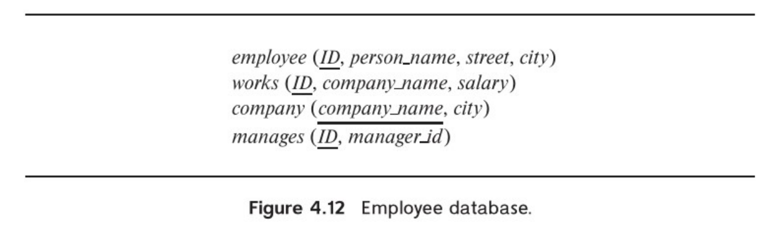
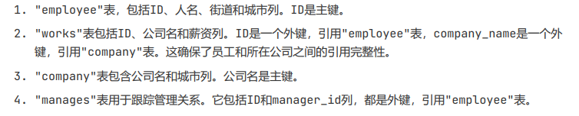
第三次作业 4.7

Slide 17
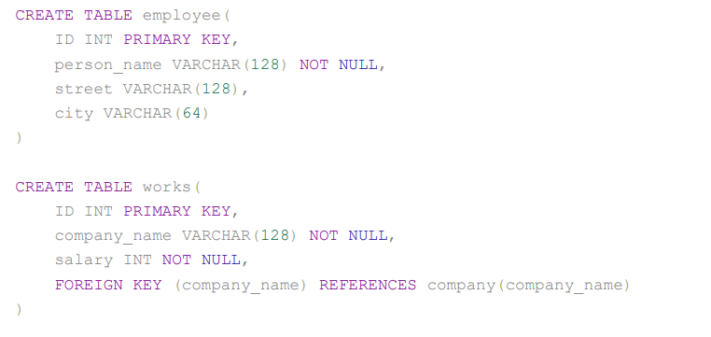
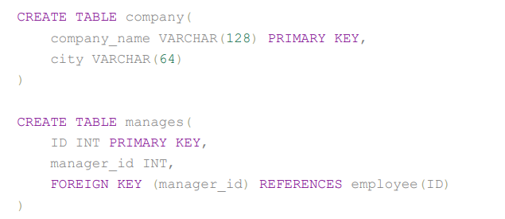
第三次作业 4.7

Slide 18
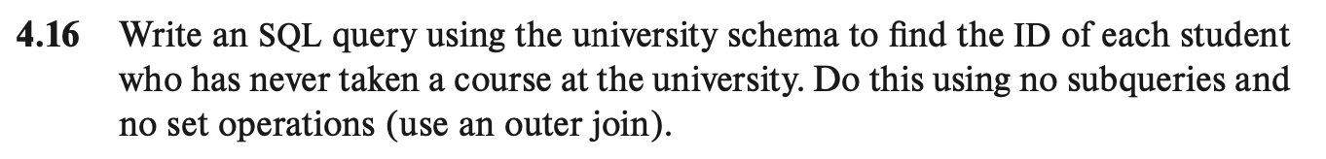
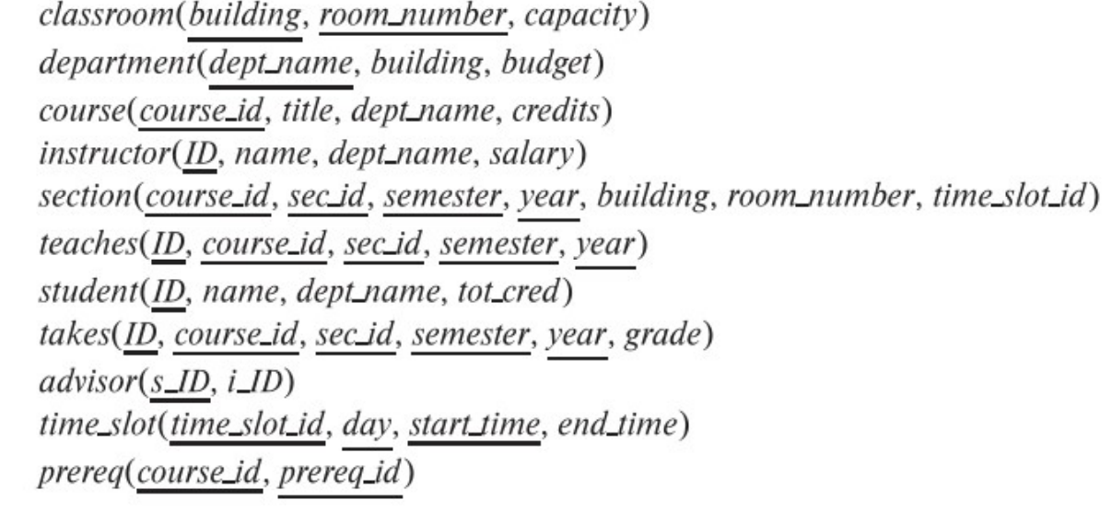
第三次作业 4.16

Slide 19
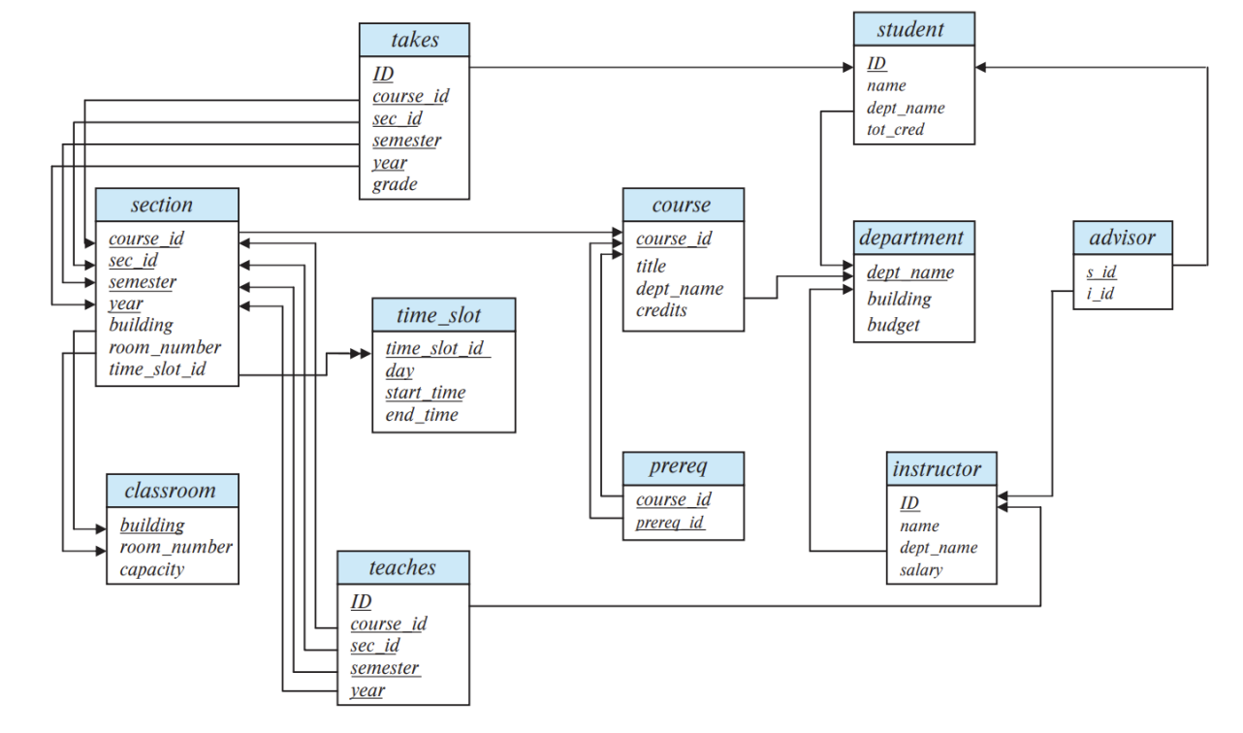
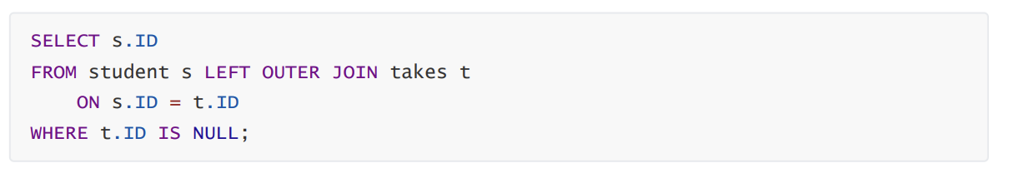
第三次作业 4.16

Slide 20
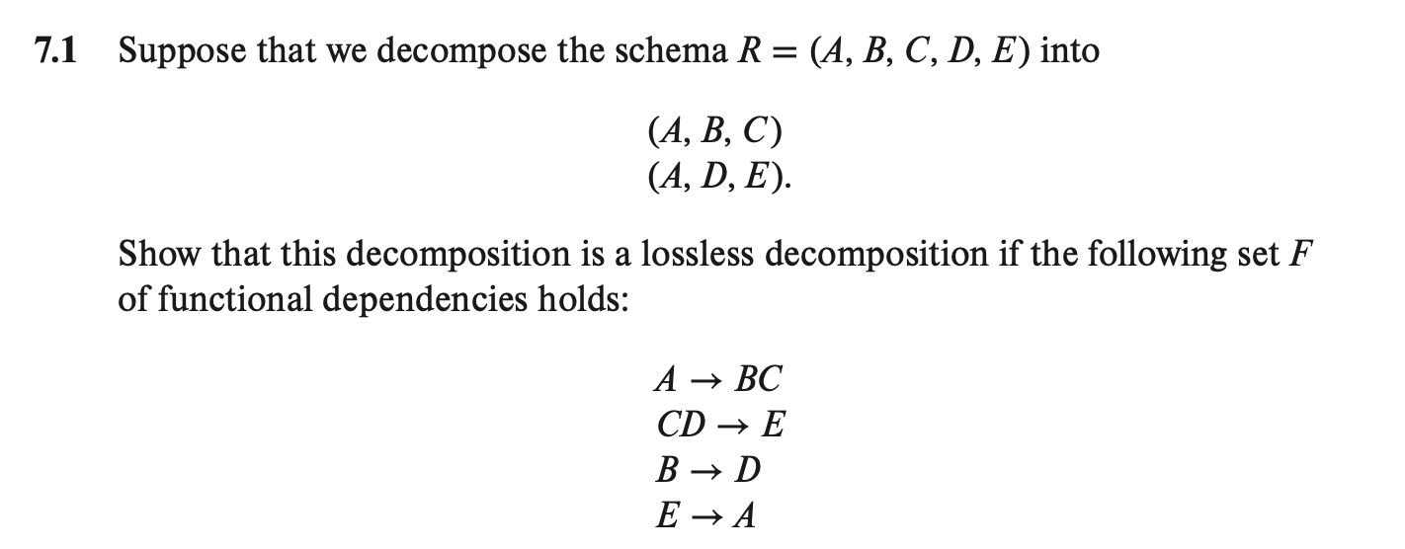
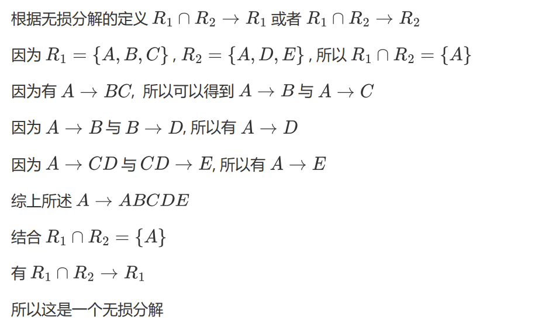
第四次作业 7.1

Slide 21
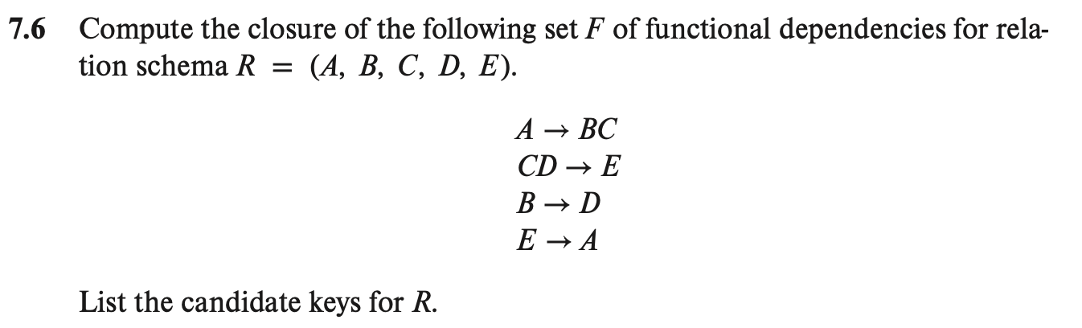
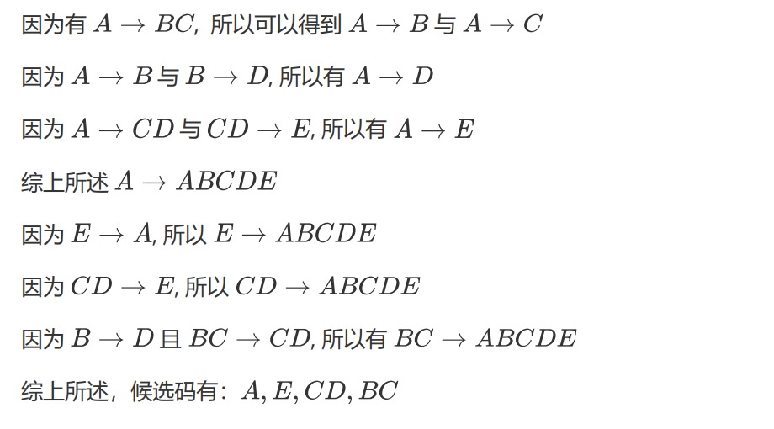
第四次作业 7.6

Slide 22
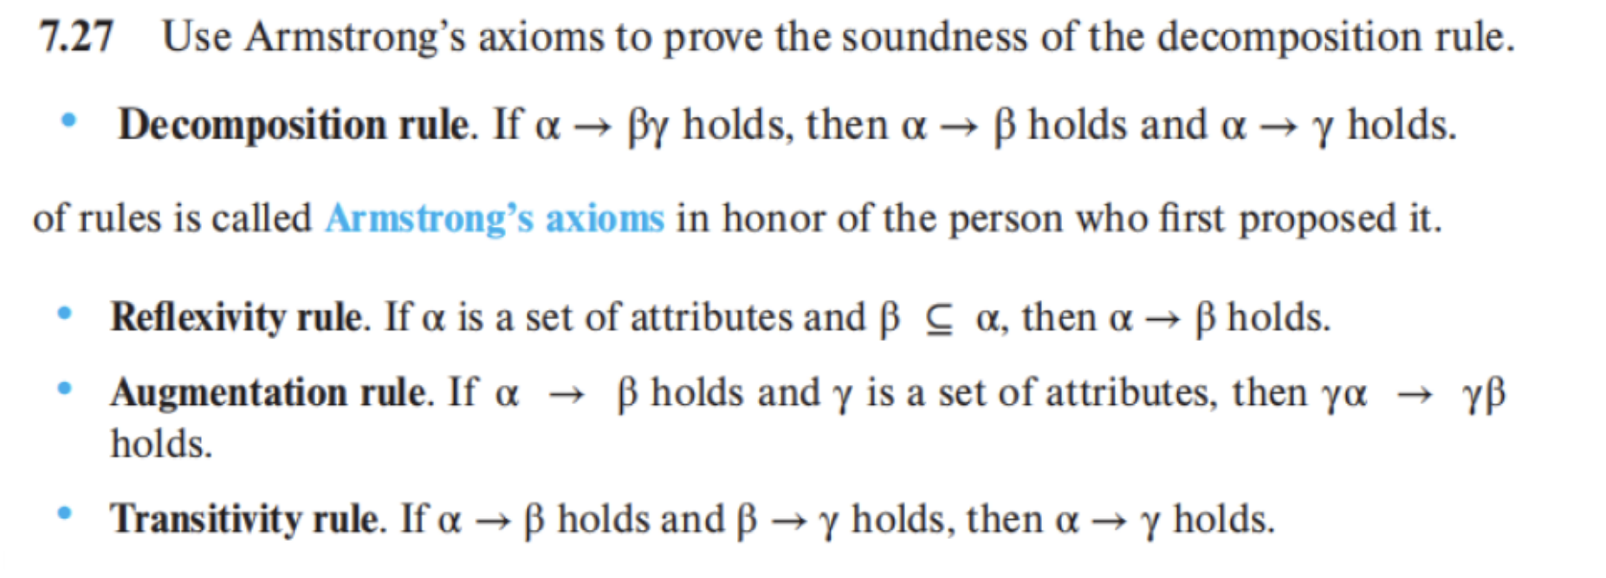
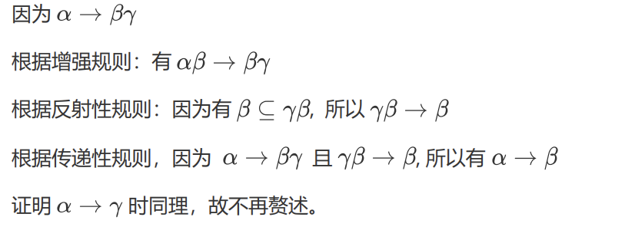
第四次作业 7.27

Slide 23
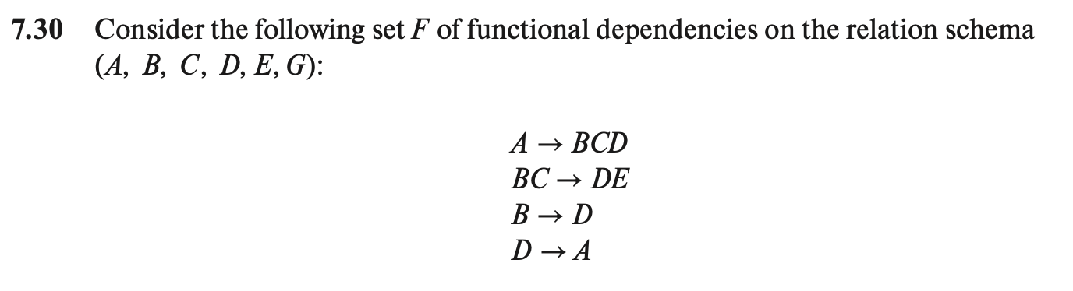
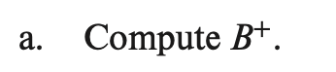
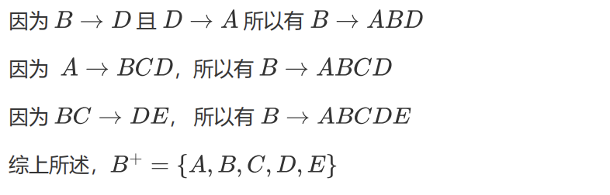
第四次作业 7.30

Slide 24
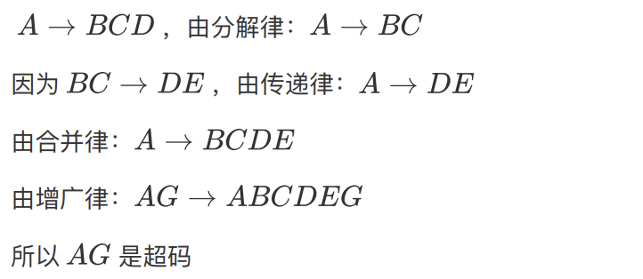
第四次作业 7.30

Slide 25
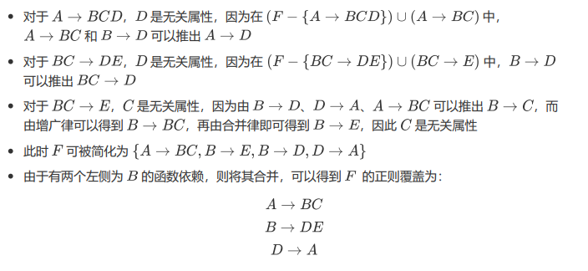
第四次作业 7.30

Slide 26
第四次作业 7.30
正则覆盖中没有多余的函数依赖
所以属性集是正则覆盖中其它函数依赖组成的子集
所以三个函数依赖都有自己的关系
$$R_{1}\left(A,B,C\right)$$
$$R_{2}\left(B,D,E\right)$$
$$R_{3}(D,A)$$
$AG$是超码且上述关系没有原关系的超码，所以需要添加
$$R_{4}(A, G)$$
最终结果为
$$R_{1}\left(A,B,C\right)$$
$$R_{1}\left(B,D,E\right)$$
$$R_{3}\left(D,A\right)$$
$$R_{4}(A,G)$$

Slide 27
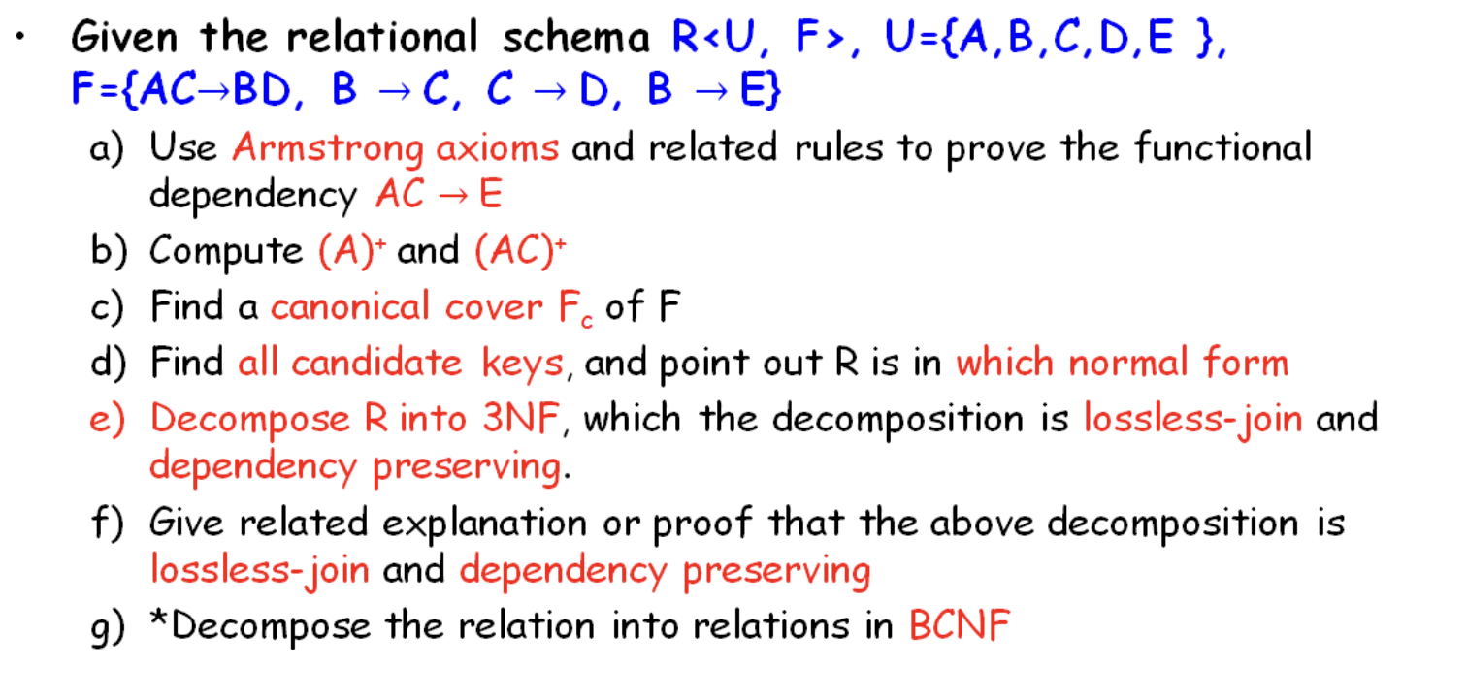
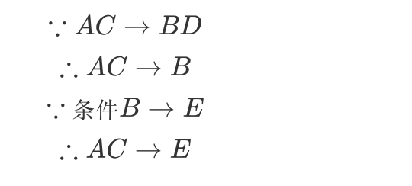
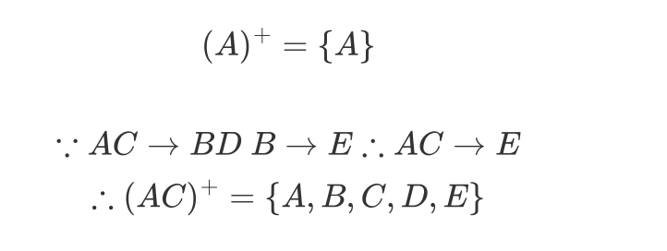
第四次作业 7.30
a)
b)

Slide 28
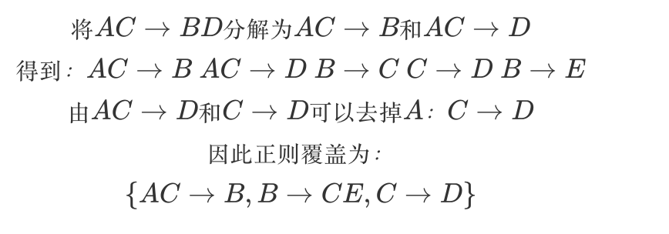





第四次作业 7.30
c)
d)
e)

Slide 29


第四次作业 7.30
f)
e)
$分解$结果为$\{A,B,C\},\left\{B,C\right\},\left\{B,E\right\},\{C,D\}$

Slide 30



第五次作业

Slide 31


第五次作业

Slide 32


第五次作业

Slide 33

第五次作业

Slide 34

第六次作业

Slide 35

第六次作业

